Slide 1
Untangling Blockchain: A Data Processing View of Blockchain Systems
Team 13
Tathagato Roy, 2019111020
Snehal Kumar, 2019101003
Rutvij Menavlikar, 2019111032
Paper by: Tien Tuan Anh Dinh, Rui Liu, Meihui Zhang ∗ , Member, IEEE, Gang Chen, Member, IEEE, Beng Chin Ooi, Fellow, IEEE, and Ji Wang

Slide 2
Motivation:
To survey the blockchain technology and compare its performance with database systems
Challenge:
Requires building an evaluation metric for performing quantitative analysis and comparative study of blockchain platforms and its key components
Bring design principles from databases to enhance blockchain performance
Idea:
BLOCKBENCH - performance of private blockchains against data processing workloads.
Comprehensive evaluation of Ethereum, Parity and Hyperledger

Slide 3
Introduction

Slide 4
Introduction
A blockchain is essentially an append-only data structure maintained by a set of nodes which do not fully trust each other. Also, these nodes keep replicas of the data and agree on an execution order of transactions.
Initially blockchain got it’s fame from the success of Bitcoin. While Bitcoin’s original design stored it’s system states as coins, if they were to store a replica of a state machine model performing some operation, blockchain’s applications could be broadened from the scope of just cryptocurrencies and they could support user defined and Turing complete state machine models.
Blockchains can be classified in two major classes:
Private (or Permissioned) Blockchains- Blockchain environment in which all the participants are authenticate or known.
Public (or Permissionless) Blockchains- Blockchain environment in which anyone can join or leave.

Slide 5
Blockchains: Private vs Public
In a typical blockchain system the nodes maintain a set of shared global states and perform transactions modifying the states, while storing the historical state and linking the current state to its predecessor.
Each node in blockchain broadcasts a set of transactions which is collected by special nodes (miners) into blocks, check validity of the block, and append block to blockchain by following a consensus protocol.
PRIVATE | PUBLIC
Hyperledger is among most popular private blockchains. The identities of all the nodes are known. Hyperledger uses practical Byzantine Fault Tolerance (pBFT) consensus protocol. Private blockchains can support smart contracts with complex transaction logics. | Most well known example is Bitcoin. Bitcoin uses proof-of-work (PoW) consensus protocol as it is tolerant of Byzantine failure. Although PoW is prone to probabilistic failure, which can result in branching.

Slide 6
State of The Art
Distributed Ledger (Crypto Currencies and Digital Assets)
Bitcoins and DogeCoins (Transaction Based Model, Public and only 1 Ledger)
Ethereum (Account Based Models)
General Applications (Most of these offer Turing Complete Smart Contract code support and advance data models.
Business Logics (HydraChain,Quorum) like Crowdsourcing to Complex Investment Funds
Digital Assets
BigChain, Corda(Track Asset History, typically private, can have more than 1 Ledger)
Ripple, IOTA issue their own assets and offer their ledgers as platform for trading
Notes:
Crypto :Ledger must be open and must have only only branch

Slide 7
2. Cryptography
Creation of Public Key Certificates for identity generation and management
Corresponding Private key is used to claim ownership and sign Transactions
Private Blockchains like HyperLedger has an added access Control layer on top
Transaction Privacy is provided by services like ZeroCash and ZeroCoin based on Zero Knowledge Proofs.
There exist many advanced signature schemes like MultiSig
3. Consensus
Proof Of Work (Solving a hard Cryptographic problem of a given difficulty)
Proof Of Stake (Puzzle Difficulty is inversely proportional to Miners stake in the Network)
PBFT (Voted Consensus)
TenderMints’ Modification (Voting is power is proportional to Stake, improves speed in the network)
By using Trusted Hardware setups like IntelSGX and ARM Trustzone, we can ensure the nodes are running specific software, thus relaxing the assumption the nodes are Byzantine. This allows the use of more efficient protocols like Proof of Elapsed Time.
Notes:
Crypto :Ledger must be open and must have only only branch

Slide 8
4. Smart Contracts
Bitcoin (200 Opcodes allowing Stack Based Program)
Turing Complete Languages like Solidity, Serpent from Ethereum
HyperLedger uses Docker containers to run language agnostic smart Contracts
Using Turing Complete languages introduces to software bugs which makes it vulnerable to many forms of attacks.
Kadena, Tezos, Corda have more expressive languages than Bitcoin but avoid Turing Complete Languages for extra Security
Notes:
Crypto :Ledger must be open and must have only only branch
Trusted Hardware skipped.

Slide 9
BLOCKBENCH

Slide 10
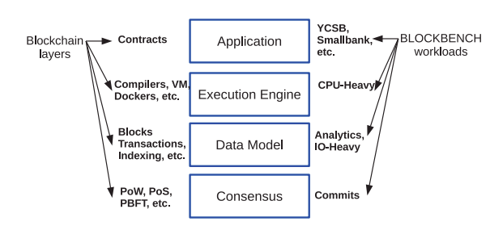
Blockbench
Quantitative framework for benchmarking blockchains as data processing platforms.
Evaluates different layers/abstractions separately
Selected Blockchains : HyperLedger,Ethereum,Parity
Desired Blockchain can be integrated to the framework’s backend,smart contract can be deployed to send transactions and query blockchain states.
Driver takes an input workload and send transactions to the blockchains
Notes:
The blockchains need to private,Turing Complete Smart Contracts
The consensus layer implements the consensus protocol.
The data model layer contains the structure, content and
operations on the blockchain data. The execution layer
includes details of the runtime environment for execut-
ing smart contracts. Finally, the application layer includes
classes of blockchain applications.
The chosen ones are most mature and widely used
Throughput :multiple clients and multiple threads can be use
Latency : Driver implements latency,one after another

Slide 11
Selected BlockChains

Slide 12
Evaluation

Slide 13
Evaluation Metrics
Evaluation Metrics :
Throughput : number of successful transactions per second
Latency : The response time per transaction
Scalability : Changes to the Throughput and Latency with increasing nodes and workloads
Fault Tolerance : Protection against node failures
Security Metrics : Ratio between total number of blocks vs total no confirmed blocks.
Workloads (Macro and Database)
YCSB(used for NoSQL) and SmallBank
Workloads (Micro)
DoNothing (sends empty transactions)
Analytics
IOHeavy (asks lot of IO read/write Transactions)
CPUHeavy(asks to perform QuickSort)
Notes:
Lower ratio,better
Other benchmarks :
EtherID : domain name registrar
Doubler : Pyramid Scheme
Waves Presale
Donothing test consensus
Analytics test Data model
IOheavy Lot of random read/writes,persistent storage states

Slide 14
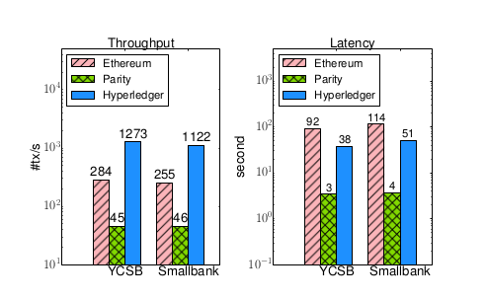
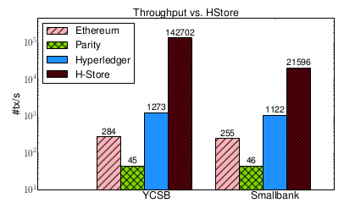
Throughput and Latency
Hyperledger outperforms Ethereum because ethereum uses PoW while HyperLedger uses pBFT. With 8 Servers, the communication cost is cheaper compared to blockmining (here set to 2.5secs per Block)
Parity uses a simpler consensus protocol called PoA but is slow due to constant transaction rate.
All three are much slower than H-store. H-store doesn’t incur overhead due to consensus protocols
Greater deterioration in Smallbank(Complex transactions) for Hstore compared to blockchains as no cost due to distributed transaction cost.
Notes:
Peak PErformance for 8 server and clients

Slide 15
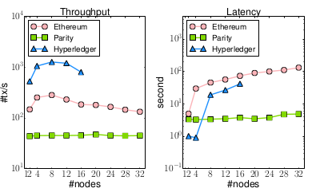
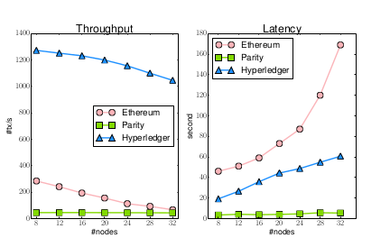
Scalability
Parity’s performance remains constant because it has constant transaction rate
Hyperledger fails beyond 16 nodes.This is because it doesn’t reach consensus.The message queue is saturated with client messages ,forcing server messages to be dropped.It is well know PBFT is sensitive to network conditions.
For ethereum,larger networks require larger difficulty to account for propagations delays.
Another reason for slow performance is only 8 servers receive any particular transaction,hence network capacity is not fully utilized always.
Notes:
First image,same number of clients and servers
Second image 8 clients fixed.

Slide 16
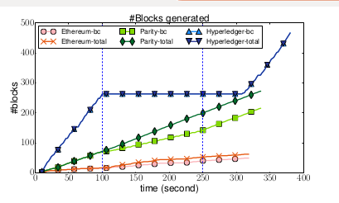
Fault Tolerance
Security Vulnerability
Ethereum unaffected by failure suggesting failed servers are not involved in mining
Parity provides time slices to authorities(validators) to append blockchains.Failure of 4 nodes provides greater time slices to the remaining block,making parity fault tolerant to clashes
Hyperledger fails as PBFT can tolerate upto N/3 Failures
Hyperledger doesn’t allow
Ethereum and Parity sees upto 30 % of the new blocks in the partitioned network,making it vulnerable to double spending and selfish mining attack
Notes:
Experiment details : ran system with 12-16 servers for 5 minutes,after which 4 nodes are crashed.
Partition runs between 100 -250 second,(8 servers 8 clients)
HyperLedger doesn’t allow forks because its PBFT protocol protects against it.
Selfish mining attack are attacks when a validated block is withholded from broadcasting.

Slide 17
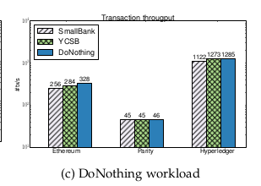
Execution Layer
Consensus Layer
A smart contract is deployed to sort a array present in descending order.Although EVM used by both Parity and Ethereum,Parity have an more optimised implementation
Hyperledger is runs on a native machine in a docker environment, thus doesn’t need to compute expensive high level EVM byte Code
All three use single core architecture to run smart contract
The DoNothing Workload is used for evaluating the overhead due to consensus protocols
Only Ethereum shows a significant(10 %) throughput increase compared to YCSB.Hence therefore execution of YCSB transactions are responsible for 10 % overhead
Notes:
10 M elements
473 MB Hyperledger
22 GB Ethereum (runs out of memory)

Slide 18
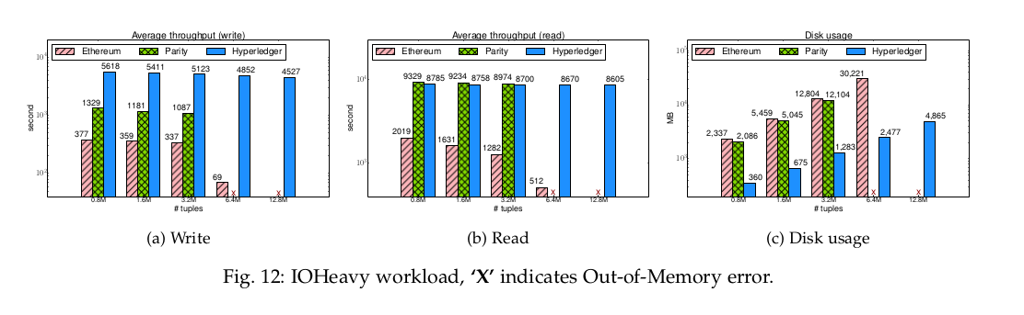
Data Model
Notes:
c) Ethereum and Parity have similar index structure(data storage model) and hence incur same disk usage.Hyperledger has much more simpler key-value storage structure.
b,a) Parity store all data in memory,hence faster but cant’ handle large data
Ethereum stores partial data in cache.LRU eviction
HyperLedger uses RocksDB,more efficient at scale.

Slide 19
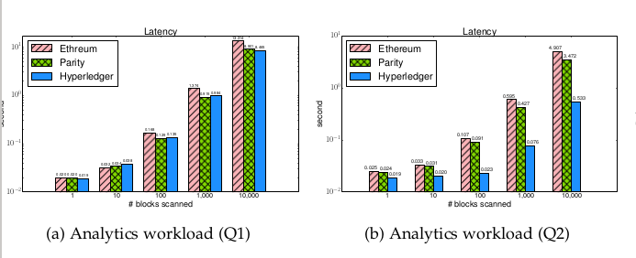
Analytics Workload
12000 Accounts with fixed balance and 10000 blocks with 3 transactions per block
A transaction transfer values from one account to another
2 types of Query Q1 and Q2
Similar performance in Q1 for all three
But in Q2, client sends one request per block to Ethereum and Parity but only 1 request overall to Hyperledger (due to customized implementation)
Notes:
Q1 : Sum of all transaction values from block i and j
Q2 : max value of a transaction on account id from block i and j
Main bottleneck RPC

Slide 20
Discussion

Slide 21
Reviewing the study results
Leveraging the abstraction layers to analyse design vs performance tradeoffs
Eg: performance vs scalability in Parity (IOHeavy Workload), support for queries vs optimizations in Hyperledger (Analytic Workload)
Helps in identifying key features for various blockchain platforms
Platforms are not ready for public deployment*
Designs are still changing, lack of other applications
Portability issue of smart contracts between blockchain systems*
Different codebase and protocols not compatible with each other
Limited data processing capability vs databases
Need for Byzantine tolerant data processing P2P systems
Availability of more efficient hardware
* As of publishing date
Notes:
The consensus layer implements the consensus protocol. DoNothing
The data model layer contains the structure, content and operations on the blockchain data. IOHeavy, Analytics
The execution layer includes details of the runtime environment for executing smart contracts. CPUHeavy
The application layer includes classes of blockchain applications

Slide 22
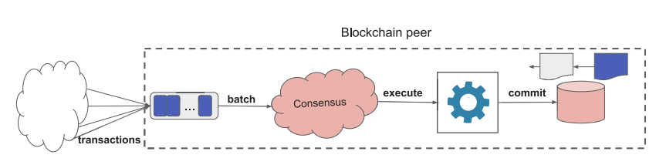
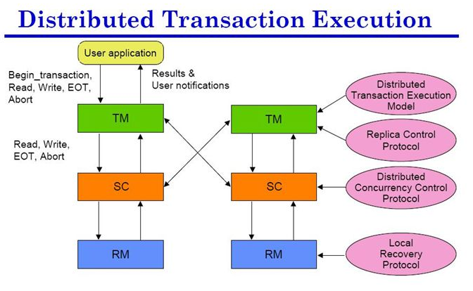
Addressing the Issues
Applying DB concepts in blockchain due to similarity in lifecycle
Decoupling the layers
Enables independent upscaling and optimizations of layers. eg. Tezos
Eliminates the complexity in upgrading/changing existing data model
Using latest hardware
Improving performance by using CPUs and memory
Higher fault tolerant and scalability using trusted hardware
Sharding
Partitioning blockchain reduces cost and transaction processing eg. Corda
Development of sharding Byzantine tolerant consensus protocols
Supporting declarative language
Easy to build smart contracts intuitively with support for low level optimizations
Use in applications atop blockchain. eg. Hawk

Slide 23
Conclusion
Surveyed existing blockchain technologies
Analysed SoTA system using the key concepts of blockchain
Proposed BLOCKBENCH evaluation framework for data processing in blockchain systems
Reviewed the results and proposed using blockchain P2P Byzantine tolerance in database and using database concepts to improve performance in blockchain processing

